Slide 1
Prevention Agenda 2019-24 Vision:
New York is the Healthiest State
for People of All Ages
Notes:
In concert with our support for Healthy Aging we updated our vision. This vision reflects where we want to be.
It captures an ambition to do the best we possibly can to improve the health of all New Yorkers.
And to progress from being ranked 26th in 2008, when the Prevention Agenda began, to 10th in the most recent America’s Health Rankings by state.
It also reflects our appreciation for changes in demographics and the increasing number of older people living in New York State. We want to be the healthiest state for people of all ages.
(The America’s Health Rankings have started ranking states on senior health. NY ranks 18th, up from 17th – the wrong direction – a year ago. )

Slide 2
NYS Prevention Agenda
Goal is improved health status of New Yorkers and reduction in health disparities through increased emphasis on prevention.
Call to action to broad range of stakeholders to collaborate at the community level to assess local health status and needs; identify local health priorities; and plan, implement and evaluate strategies for local health improvement.
Led by Ad Hoc Committee appointed by the NYS Public Health and Health Planning Council.
Notes:
The Prevention Agenda is NYS’ public health improvement plan. Its goal is to improve health status and reduce health disparities across the state by focusing on Prevention. It is a state action plan but also a call for local, collaborative action to identify and address local health priorities.
It has been incorporated into state health reform efforts including the DSRIP program. The Ad Hoc Committee has been pleased to work with the Office of Health Insurance Program’s new office of social determinants of healthand looks forward to congoing collaboration with them.
The NYS Public Health and Health Planning Council, its Public Health Committee and the Ad Hoc Committee to Lead the Prevention Agenda have played a critical role in supporting the implementation of the Prevention Agenda over the years and in leading the effort to update it for the next six years.

Slide 3
Prevention
Partners
The Ad Hoc Committee appointed by the NYS Public Health and Health Planning Council played an essential role in leading the development of the Prevention Agenda.
Notes:
The Public Health Committee and the Ad Hoc Committee to Lead the Prevention Agenda (part of PHHPC) have played a critical role in supporting the implementation of the Prevention Agenda over the years including the effort to update it for the next six years.
The work of updating and implementing the Prevention Agenda relies on collaborative efforts of hundreds of state and local partners statewide.

Slide 4
The Health Across All Policies and Age-Friendly Vision
Advance a Health Across All Policies approach to incorporate health considerations into policies, programs and initiatives led by non-health agencies.
Consider how all of our policies, programs and initiatives support us achieving the goal of becoming an age friendly state.
Long term goal is to embed Health Across All Policies and considerations for Healthy Aging into all aspects of our government work.
Notes:
We need to focus on the determinants of health, and advance a Health Across All Policies approach to incorporate health considerations into policies, programs and initiatives led by non-health agencies.
As first step, we need to consider how all of our policies, programs and initiatives are age friendly, and support us achieving the goal of becoming an age friendly state.
Long term goal is to embed Health Across All Policies and considerations for Healthy Aging into all aspects of our government work. This is just the first step! Governor’s 2017 State of the State Message called for NYS to incorporate health considerations into policies, programs and initiatives led by non-health agencies and to consider how initiatives could support becoming first age friendly state.
NYS DOH and Governor’s Office implementing specific HAAP and Healthy Aging projects and incorporating into Prevention Agenda
Signed Executive Order #190 that calls on all agencies to consider the health impact of their policies and programs and to include language in procurements, contracting and grantmaking that gives benefit to contractors who similarly include considerations to improve overall community health within their work.

Slide 5
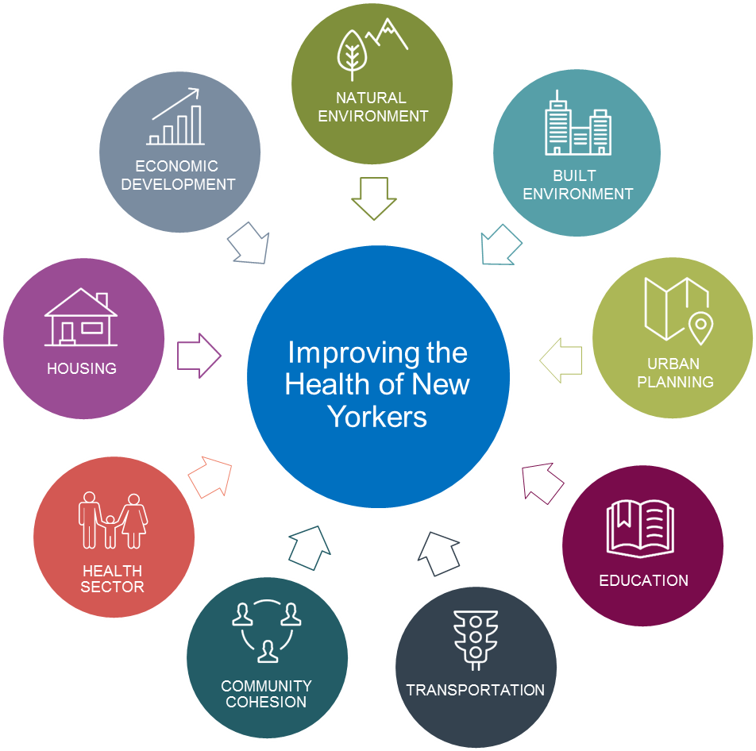

Traveling Together…
Health Across All Policies
Age-Friendly NYS
AARP
NYS PREVENTION AGENDA 2019-2024
NYAM
Notes:
We have updated the Prevention Agenda at the same time that NYS is working to incorporate a Health in All Policies approach to government and to implement policies to support our becoming the first age friendly state ever, as recognized by the AARP.
The DOH, along with Aging and Department of State and the Governor’s office are leading a foundation funded effort to integrate HAAP and Healthy Aging into government policies and actions. State agencies have met several times with Secretary for Health Paul Francis and Commissioner Zucker, most recently in January of this year.
Six years ago, the Ad Hoc committee invited Office of Mental Health and OASAS to join it because we added the Promote Mental Health and Prevent Substance Abuse priority. Now in tandem with our HAAP and HA efforts we have Department of Ag and Markets, the Department of State, the Office for the Aging and the Department of Environmental Conservation as active members of the ad Hoc Committee.
Incorporating health in all policies will help us achieve our statewide Prevention Agenda goals. It will also help local communities address their local priorities. At the panel later this morning you will learn about what some of these state agencies are doing and how you can incorporate these efforts in your local community health improvement planning.

Slide 6
Prevention Agenda tied to
Local Community Health Improvement Process
Local community health improvement process in NYS informed by:
  Public Health Law that requires local health departments to conduct Community Health Assessments and Community Health Improvement Plans and hospitals to complete Community Service Plans
  Voluntary national accreditation of state and local public health agencies that requires them to complete a periodic community health assessment and community health improvement plan
  ACA requirement for non profit hospitals to conduct community health needs assessment
  Goals for multi-stakeholder collaboration to improve health
Notes:
This cycle’s guidance was about promoting collaboration in the planning cycle.
This focus on collaboration led to submission of a large number of joint plans
It was decided to retain the five priorities for the new cycle

Slide 7
Prevention Agenda 2019-2024
Priority Areas
Prevent Chronic Diseases
Promote a Healthy and Safe Environment
Promote Healthy Women, Infants and Children
Promote Well-Being and Prevent Mental and
Substance Use Disorders
Prevent Communicable Diseases
Notes:
These are the 5 updated priorities
They are based on the underlying causes of death in NYS, and the availability of evidence-based interventions to address these issues.
As you can see these look a lot like the current set of priorities.
Here are a couple notable changes:
The leadership of OMH, OASAS working on the mental health and substance abuse priority felt it was important to have a change in the title to promote well-being. CDC defines well-being as a relative and dynamic state where one maximizes his/her physical, mental and social functioning in the context of supportive environments to live a full satisfying and productive life.
In addition the terminology was changed from Substance Abuse to Substance Use Disorder.
We have shortened the fifth priority to a manageable title – this still includes goals for reducing HIV, STIs, Hepatitis C, vaccine preventable disease, health care associated infections, and anti microbial resistance – just not all listed out in the title

Slide 8
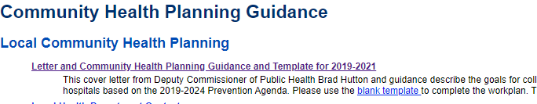
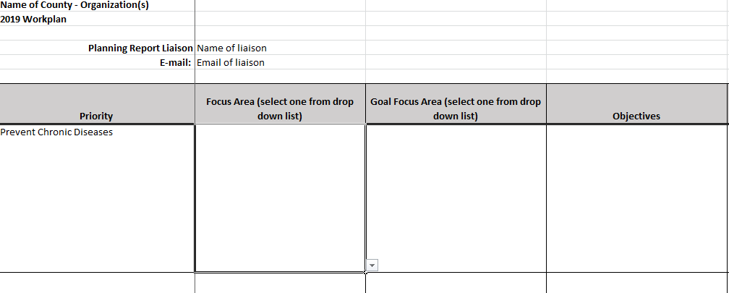
2019 -2021 Community Planning Guidance
https://www.health.ny.gov/prevention/prevention_agenda/2013-2017/resources_for_communities.htm
Robust community health needs assessment
At least 2 Prevention Agenda priorities/focus areas
Priorities identified collaboratively with partners
At least one of these should address a disparity
Identify best practice interventions & track progress
Plan on organization website by March 31, 2020

Slide 9
Action Plan for Each Priority Area
Focus Areas
  Goals
    Measurable Objective(s)
    Evidence Based Interventions
    Resources for Implementation
    Identification of populations/age groups affected and social determinants of health
    Identification of organizations that play leading or supporting roles
Notes:
Priority specific committees met over the summer led by NYS agency subject matter experts and including many members of the Ad Hoc Committee. They drafted the priority specific action plans. Each plan includes
Focus Areas
Goals
Measurable Objectives – the majority of these will be updated for the Dashboard
Evidence Based Interventions with resources for implementation
The identification of specific populations/age groups affected
Whether or not the EBIs are addressing the social determinants of health
The Identification of organizations that can play leading or supporting roles
Let’s go over the Focus areas and goals for each Priority Area – highlighting SOME examples of what’s new.

Slide 10
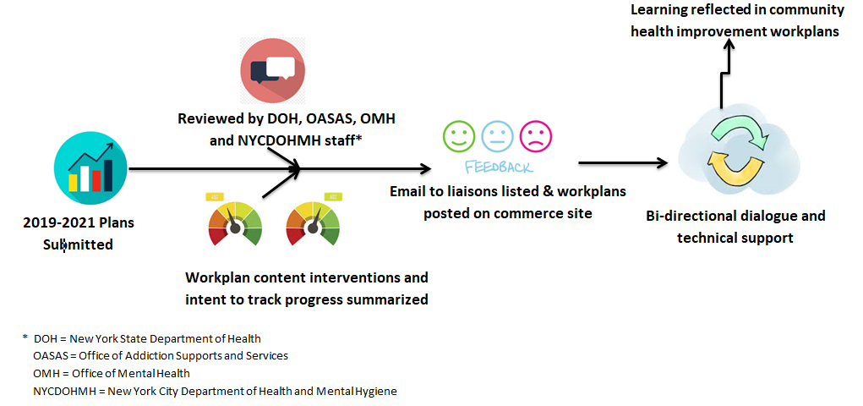
Review Process

Slide 11
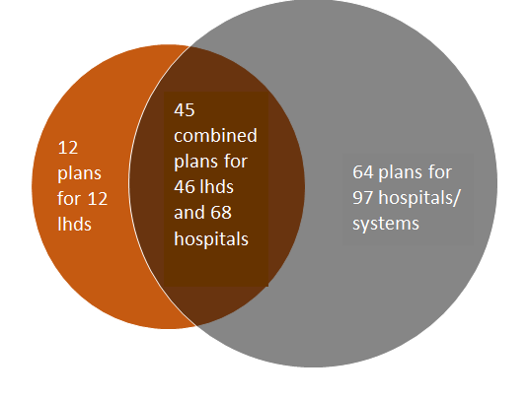
2019-2021 Prevention Agenda Plans Submitted
LHDs & hospitals could submit one plan/county or by organization, or as a health system
Regional plans could be attached and supplemented county plans
121 plans by 58 LHDs and 165 Hospitals

Slide 12
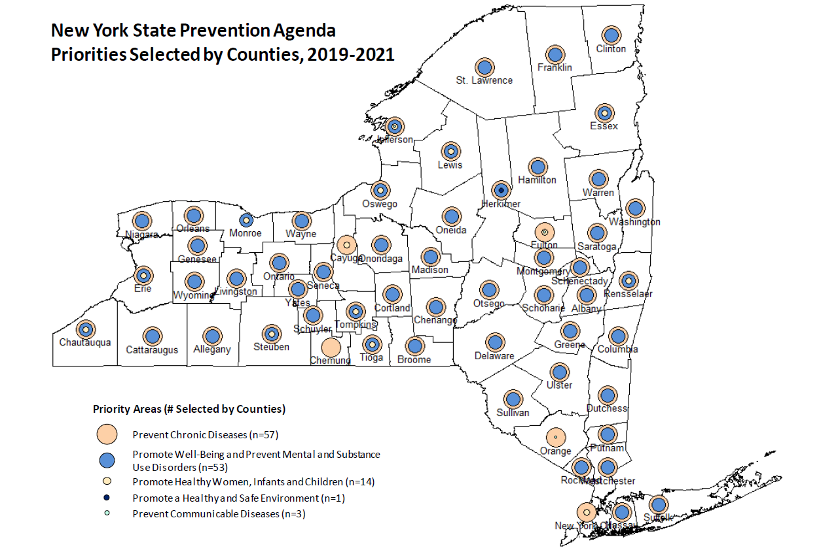

Slide 13
Priorities selected by local health departments and hospitals, 2019-2021
Prevent Chronic Diseases (PCD): 57 LHDs, 161 hospitals
Promote Healthy and Safe Environment (PHSE): 1 LHD and 12 hospitals
Promote Healthy Women, Infants and Children (PHWIC): 15 LHDs and 76 hospitals
Promote Well-Being and Prevent Mental and Substance Use Disorders (PWPMSUD): 53 LHDs, and 140 hospitals
Prevent Communicable Diseases (PCommD): 3 LHDs, 37 hospitals
2019-2021 Plans: 58 Local Health Departments (LHDs) and 165 hospitals in 121 submitted plans

Slide 14
Goal 1.1 (Build well-being and resilience)
Goal 1.2 (Supportive environments)
Goal 2.1 (Underage drinking)
Goal 2.2 (Opioid misuse and death)
Goal 2.3 (ACES)
Goal 2.4 (Major depressive disorders)
Goal 2.5 (Prevent suicides)
Goal 2.6 (Reduce mortality gap)
Promote Well-Being and Prevent Mental and Substance Use Disorder Priority: 53 LHDs, 140 hospitals

Slide 15
Promote Well-Being, Prevent Mental & Substance Use Disorders =
53 LHDs, 140 hospitals

Slide 16

Background
http://www.nyhealth.gov

Slide 17
Contact
For more information, email prevention@health.ny.gov

