Slide 1
Advancing Prevention in New York State’s Mental Health System
Ann Marie Sullivan, M.D.
Commissioner
New York State Office of Mental Health

Slide 2
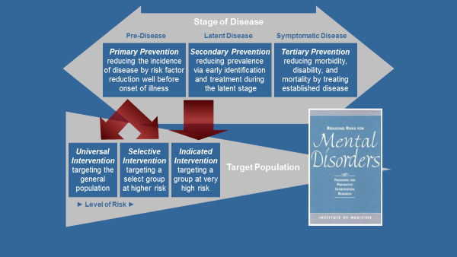
Primary, Secondary, and Tertiary Prevention

Slide 3
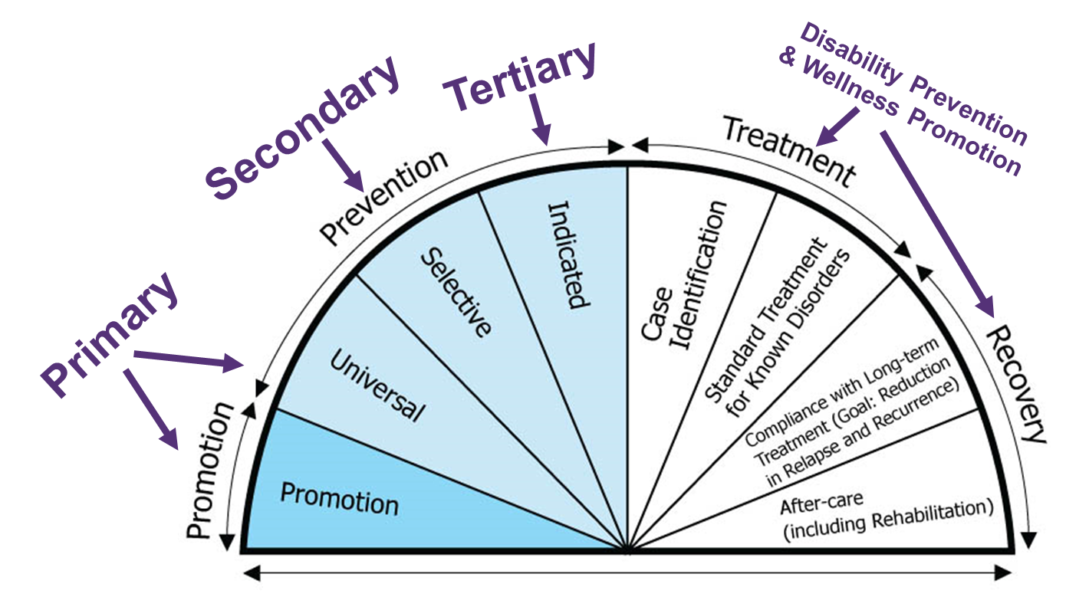
IOM Framework

Slide 4
Normative Community Settings
Schools
Primary Care

Slide 5

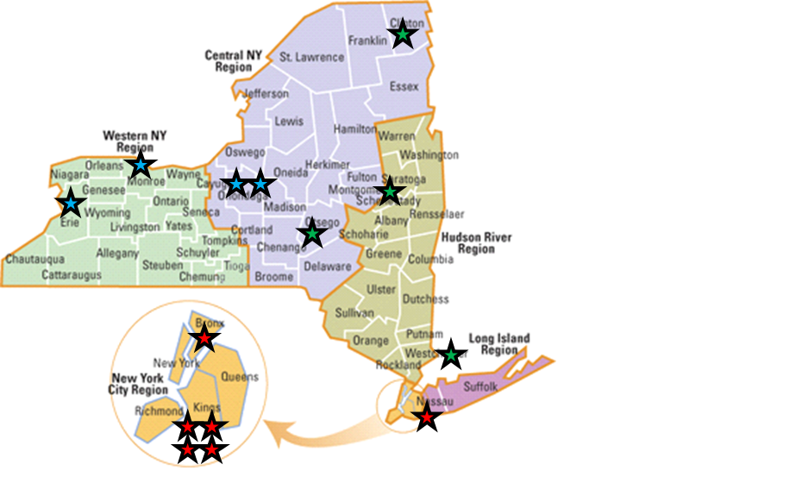

Primary Prevention in Primary Care
OMH HealthySteps- is an evidence-based, team-based pediatric primary care program that promotes the health, well-being and school readiness of babies and youth. There are currently 14 OMH funded sites that are distributed across the state and represent diverse populations in high need communities where children are disproportionately at risk for social and emotional concerns.
Project TEACH- Project TEACH provides consultation, education, training, and referrals and linkages to other key services for pediatricians, family physicians, psychiatrists, and nurse practitioners. Recently expanded, Project TEACH is set to enroll an additional 3,800 providers, and provide an additional 24,500 New York children with behavioral health consultations. Maternal depression initiative.
Collaborative Care Model/Collaborative Care Medicaid Program- Builds capacity to treat behavioral health issues in Primary Care practices. OMH launched the Medicaid program in 2015, ~350 sites currently participating, provide care for over 10,000 patients each year.

Slide 6
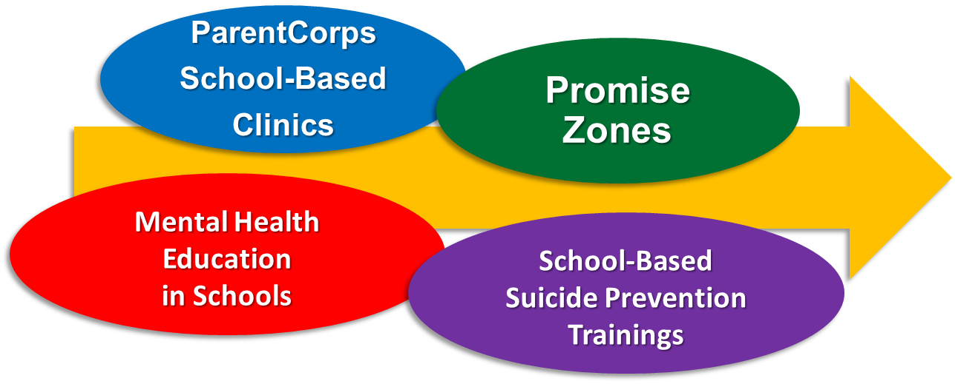
Primary and Secondary Prevention in Schools
Mental Health Education- As of 2018-2019-schools across the state are required to teach about mental health as part of a broader health/emotional social wellness curriculum.
ParentCorps- ParentCorps is a universal prevention intervention for all children in Pre-K attending the selected school, with no admission criteria. All families of students can participate in the program.
School Based Satellite Clinics- 910 school-based clinic satellites across NYS. Increased from less than 300 4 years ago.
Promise Zones- A strategy that utilizes a partnership framework to improve student engagement, academic achievement, dropout prevention, social and emotional competence, establishing positive school culture and school safety in 5 regions/districts.
Suicide Prevention Trainings- trainings and technical assistance to NY schools from basic to in-depth: Suicide Safety Training (SST), Helping Students At-Risk (HSAR), Creating Suicide Safety in Schools, Lifelines Postvention, Sources of Strength. Nearly 13,000 school personnel trained last year!

Slide 7
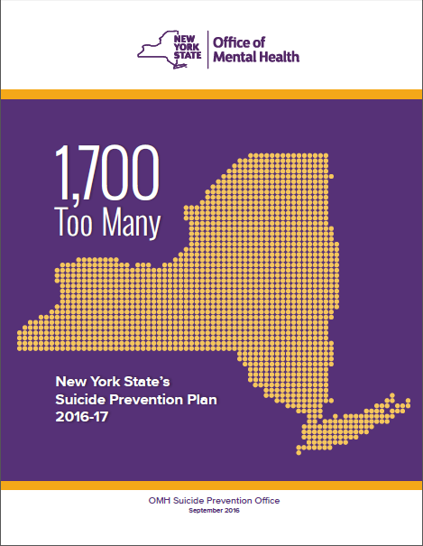
NYS Suicide Prevention: 3 Core Strategic Domains
Integrating a systemic approach to suicide prevention into health and behavioral health care systems
  Advancing Zero Suicide implementation – statewide clinic and emergency department collaboratives
2. Community interventions:
  Schools
  Community Coalitions
  Gatekeeper Training
  Specialized Interventions for High Risk Groups
    Black youth, Latina adolescents, LGBTQ community, rural residents, veterans and first responders.
3. Making use of existing and new surveillance data

Slide 8
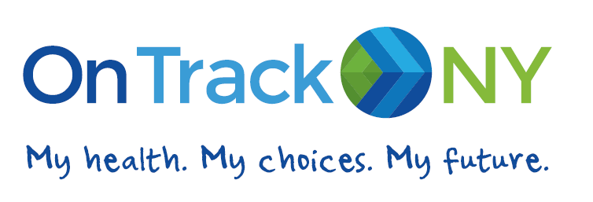
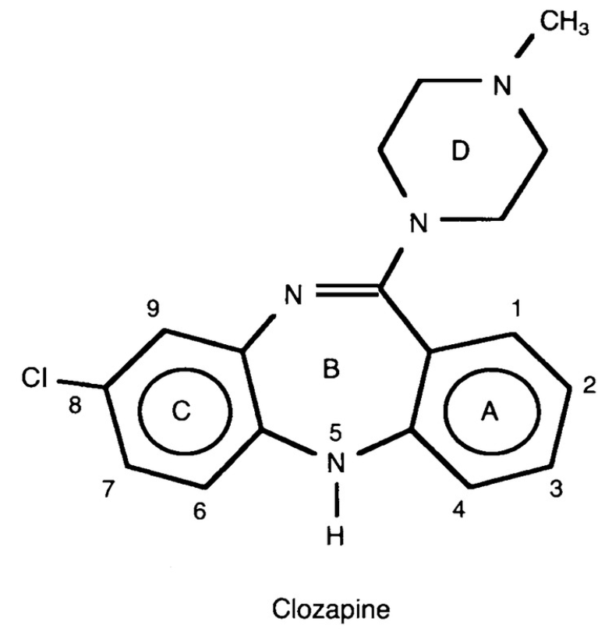
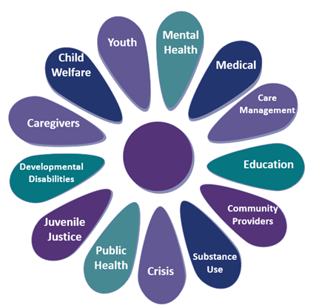
Tertiary Prevention
Crisis Redesign
Mobile Crisis
Crisis Helpline
988
Crisis Stabilization- Respite
CPEP
Clozapine Initiative
Systems of Care

Slide 9
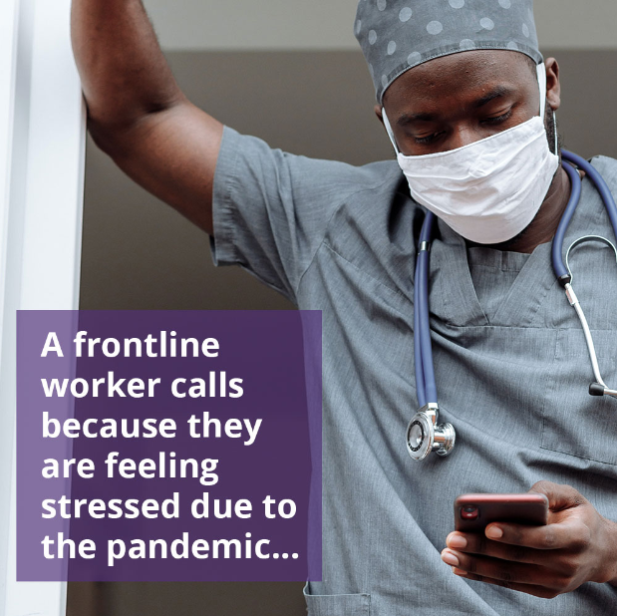
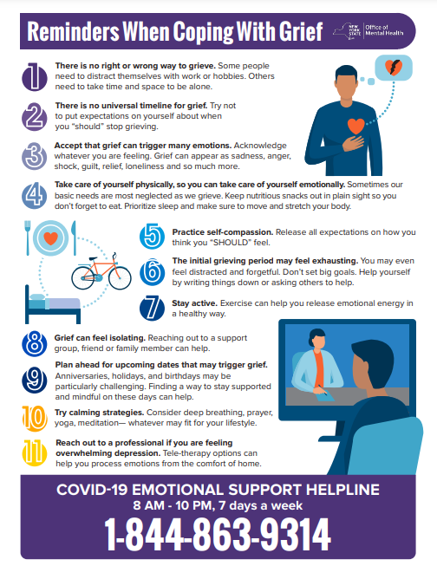
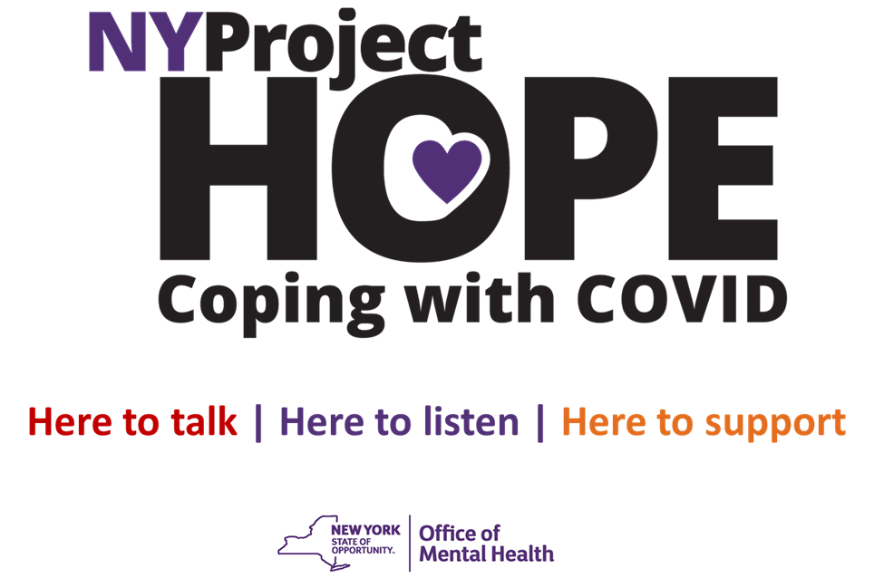
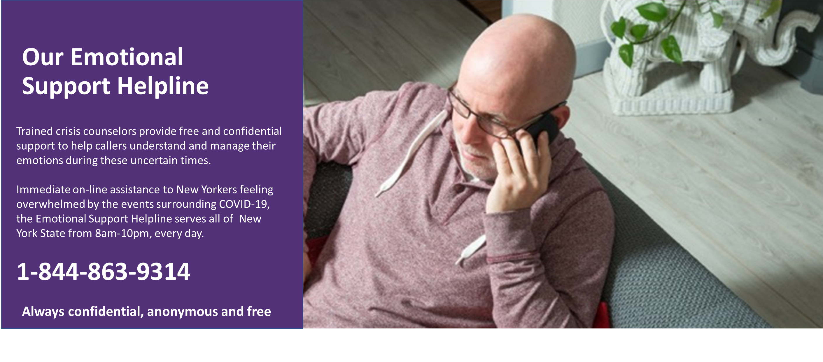
Supporting New York during COVID-19

Slide 10
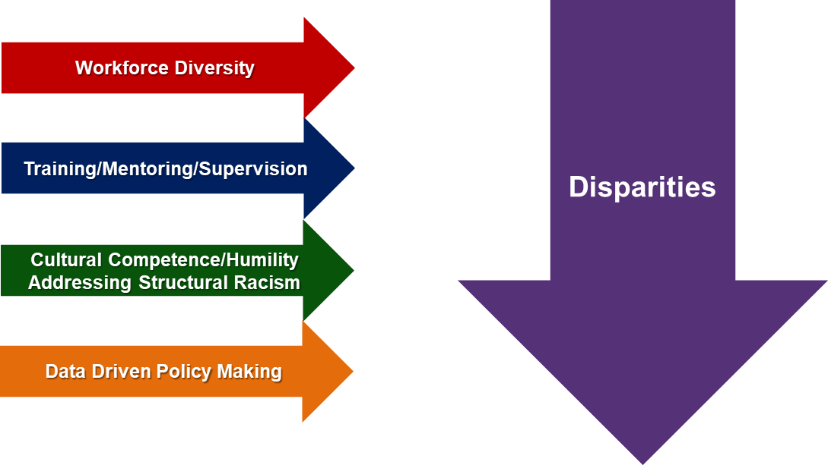
Eliminating Disparities
OMH strives to address the needs of populations that historically and currently face discrimination, understanding that discrimination leads to stress-related emotional, physiologic, and behavioral health changes.

Slide 11
OMH and the New York State Prevention Agenda
Promote Well-Being and Prevent Mental and Substance Use Disorders Action Plan
Goal 1.1 Strengthen opportunities to build well-being and resilience across the lifespan
Goal 1.2 Facilitate supportive environments that promote respect and dignity for people of all ages
Goal 2.3 Prevent and address adverse childhood experiences (ACES)
Goal 2.4 Reduce the prevalence of major depressive disorders
Goal 2.5 Prevent suicides
Goal 2.6 Reduce the mortality gap between those living with serious mental illness and the general population
Promote Healthy Women, Infants, and Children Action Plan
Goal 1.2 Reduce maternal mortality & morbidity
Goal 3.1 Support and enhance children and adolescents' social-emotional development and relationships
Goal 3.2 Increase supports for children and youth with special health care needs
Goal 4.1 Reduce racial, ethnic, economic, and geographic disparities in maternal and child health outcomes, and promote health equity for maternal and child health populations
Prevent Chronic Diseases Action Plan
Goal 3.2 Promote tobacco use cessation

Slide 12
THANK YOU !

