Slide 1
Federal Policy Update National Council for Mental Wellbeing

Slide 2
Public Policy Mission Statement
National Council advocates for assertive public policies that:
Ensure equitable access to high-quality services;
Build the capacity of mental health and substance use treatment organizations; and
Promote a greater understanding of mental wellbeing as a core component of comprehensive health and health care.

Slide 3
Assertive Public Policy Priorities for 2023
Strengthen the mental health and substance use workforce through initiatives aimed at improving reimbursement rates, supporting value-based contracting, removing barriers to employment and reimbursement, increasing workforce diversity, recruitment, and retention and creating a pipeline for the future workforce
Bolster substance use disorder prevention, care, and recovery by expanding access to medication-assisted treatment, overdose prevention, and recovery supports Protect and grow funding for mental health and substance use programs, mental health awareness training programs such as Mental Health First Aid, and prevention and treatment initiatives including recovery and housing supports
Increase equitable access to high-quality services by expanding CCBHCs through initiatives that ensure ongoing SAMHSA grant support, define CCBHCs in the Social Security Act, and provide adequate funding for data collection Promote comprehensive 988 implementation that ensures a robust crisis care continuum, including enhanced mobile crisis response, coordination with CCBHCs, sustainable funding, and a strong workforce
Elevate initiatives impacting justice-involved populations that focus on prevention from entering the system, pre-entry, care while in the system, re-entry and warm handoffs, and recidivism prevention Support mental health and substance use disorder parity implementation and enforcement, including consideration of enforcement mechanisms Expand access to mental health and substance use disorder services provided via telehealth, ensuring the provision of high-quality, effective care Support youth and maternal mental health and substance use prevention and treatment, including school-based initiatives to support mental health awareness and increased coverage for prenatal and postnatal care Address social determinants of health through improving access to supportive housing, including re-entry and recovery housing and additional community support
Notes:
Reyna

Slide 4
Public Health Emergency Set to expire May 11, 2023

Slide 5
PHE Flexibilities: Permanent Changes
Medicare patients can now receive telehealth services, including audio-only services, for mental health/substance use care in their homes in any part of the country if certain conditions are met.
Mental health services can be provided in the patient’s home without meeting the geographic requirement so long as an in-person visit is made with the telehealth provider within 6 months of the initiation of care.
The CY 2022 Telehealth Update Medicare Physician Fee Schedule has already codified the continued coverage of video-based mental health visits for Federally Qualified Health Centers (FQHCs) and Rural Health Clinics (RHCs) on a permanent basis.
https://telehealth.hhs.gov/providers/policy-changes-during-the-covid-19-public-health-emergency/policy-changes-after-the-covid-19-public-health-emergency/#permanent-changes
https://www.cchpca.org/resources/telehealth-301-medicares-2022-telehealth-policies-on-mental-health/
Notes:
Telehealth policy changes after the COVID-19 public health emergency | Telehealth.HHS.gov

Slide 6
PHE Flexibilities: Set to Expire
At the end of the 151-day "extension" ensured by the Consolidated Appropriations Act, 2022 the following flexibilities are set to end:
Increased flexibility regarding where the patient receives Medicare telehealth services, as well as where the services originate will revert back to the restrictions that were in place prior to the COVID-19 public health emergency.
Medicare reimbursement for mental health telehealth services will again require an in-person visit within 6 months of initial assessment and every 12 months following.
FQHCs and RHCs will no longer be able to be reimbursed as distant site telehealth providers for non-mental health services.
https://telehealth.hhs.gov/providers/policy-changes-during-the-covid-19-public-health-emergency/policy-changes-after-the-covid-19-public-health-emergency/#permanent-changes
Notes:
Telehealth policy changes after the COVID-19 public health emergency | Telehealth.HHS.gov

Slide 7
Supporting the Workforce

Slide 8
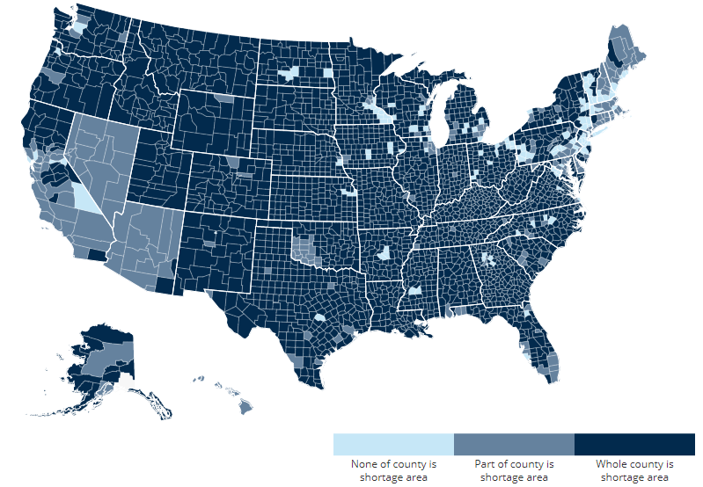
Workforce Crisis and Access to Care
Notes:
Mental Health Professional Shortage Areas, by county

Slide 9
Legislative Efforts to Address the Crisis
Increase the Workforce and Build the Pipeline:
Increase funding and eligibility re: mental health/substance use provider loan repayment programs.
Retain the Existing Workforce:
Senate Finance Committee in 2022 released draft legislation that would:
Create a demonstration project to increase mental health and substance use disorder care provider capacity under the Medicaid program.
Expands Medicare's Health Professional Shortage Area bonus program to practitioners furnishing mental health and substance use disorder services
Support the Mental Wellbeing of the Workforce
The National Council is working with offices and national partner organizations to develop legislation related to wellbeing, including grants and other funding to prioritize and improve mental wellbeing among providers.

Slide 10
Funding for Mental Health and Substance Use Services and Programs

Slide 11
Bipartisan Safer Communities Act
On June 25, 2022, the President signed the Bipartisan Safer Communities Act into law. The legislation makes historic investments in mental health services:
Expands the Certified Community Behavioral Health Center (CCBHC) demonstration program
Funding for 9-8-8, Crisis Care
Grant Program Investments
Community Mental Health Services Block Grant
Mental Health Awareness Training
Pediatric Mental Health Care Access Grants
Primary care training and enhancement programs
Provisions on Leveraging Telehealth
School-Based Mental Health Care Provisions

Slide 12
Consolidated Appropriations Act of 2023
President Biden signed into law the Consolidated Appropriations Act of 2023 on December 29, 2022, which included several notable behavioral health provisions, and over $10 billion for behavioral health programs.
National Council worked closely with Members of Congress to secure the inclusion of the vast majority of National Council’s 2022 Hill Day asks: $385 million for CCBHCs, the Mainstreaming Addiction Treatment (MAT) Act, the Medication Access and Training Expansion Act, the Mental Health Access Improvement Act, and robust funding for 9-8-8 ($502 million).

Slide 13
CAA Funding Levels
Substance Use Services: $4.2 billion (increase of $203 million) to combat the opioid epidemic. Funds are targeted toward improving treatment and prevention and workforce needs
Certified Community Behavioral Health Clinics (CCBHCs): $385 million (increase of $70 million) for CCBHCs through SAMHSA grants
988: $512 million for SAMHSA suicide prevention activities including $439.6 million for the 988 Suicide & Crisis Lifeline
Mental Health Block Grant: $1.01 billion (increase of $150 million)
National Institute of Mental Health (NIMH): $2.34 billion (increase of $120.9 million)
Mobile Crisis: $20 million (increase of $10 million) to help communities create mobile behavioral health crisis response teams
Substance Use Disorder Treatment and Recovery (STAR) Loan Repayment Program: $40 million toward educating and training SUD professionals
Parity: Authorizes $10 million for grants to states to support parity enforcement

Slide 14
Certified Community Behavioral Health Clinics (CCBHCs)

Slide 15
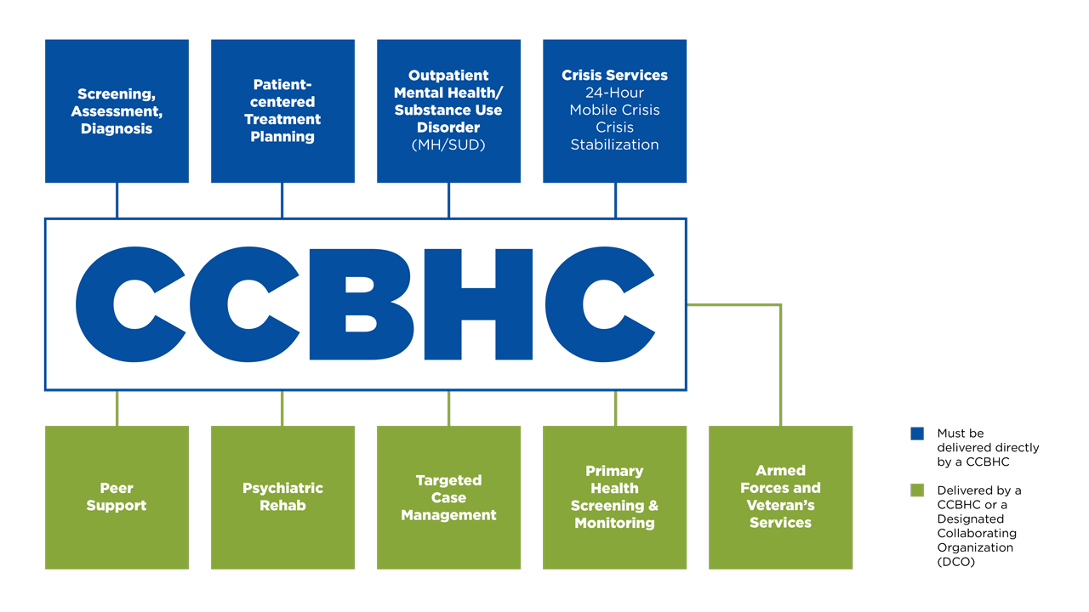
CCBHC Scope of Services
Unless there is an existing state-sanctioned, certified, or licensed system or network for the provision of crisis behavioral health services that dictates otherwise.

Slide 16
CCBHC State & Federal Actions
CCBHC state planning grant awardees are below:
10 states launched the CCBHC model through the Medicaid Demonstration: KY, MI, MN, MO, NV, NJ, NY, OK, OR, and PA.
15 states received the 2023 planning grants: AL, DE, GA, IA, KS, ME, MS, MT, NM, NC, NH, OH, RI, VT, and WV.
10 non-demo states that previously received planning grants (2016): AK, CA, CO, CT, IL, IN, MA, MD, TX, and VA.
Federal & State Actions
Established the CCBHC Model through Medicaid Demonstration
CCBHC Planning Grant (2016)
CCBHC Planning Grant (2023)
No CCBHC Actions
State Legislation to Pursue the CCBHC Model
CCBHC Clinic-level SAMHSA Grant

Slide 17
CCBHCs’ State Impact Over Time (2021 data)
New York
All-cause readmission dropped 55% after year 1
BH inpatient an overall inpatient services show a 27% and 20% decrease in monthly costs respectively
BH ED and overall ED services showed 26% and 30% decrease in monthly cost respectively
24% increase in BH services for children and youth
Oklahoma
Nearly 1,000 new jobs to health care with an economic impact of $35 million dollars and an overall reduction in unemployment.
Inpatient hospitalizations among adult clients at any Oklahoma psychiatric hospital reduced by of 93.1%.
From 2016-2021, the decreases in inpatient hospitalizations produced a $62 million dollars cost savings.
Missouri
Hospitalizations dropped 20% after 3 years, ED visits dropped 36%
Access to BH services increased 35% in 5 years, with a 156% increase in MAT
In 1 year, 20% decrease in cholesterol; 1.48-point Hgb A1c decrease
41% increase in deflection and diversion programs with law enforcement
14% decrease in spend equated to $484 saved/person served ($15.4M)
Notes:
Source:
National Council Behavioral Health Commissioners Summit, Sept. 2020; Presentation by Oklahoma Commissioner Carrie Slatton-Hodges in Jan. 2022; and cost data from research conducted by NRI and Grand Lake Mental Health Center, a CCBHC in Rural Oklahoma; and data from this impact report: https://www.thenationalcouncil.org/wp-content/uploads/2022/02/Transforming-State-Behavioral-Health-Systems.pdf

Slide 18
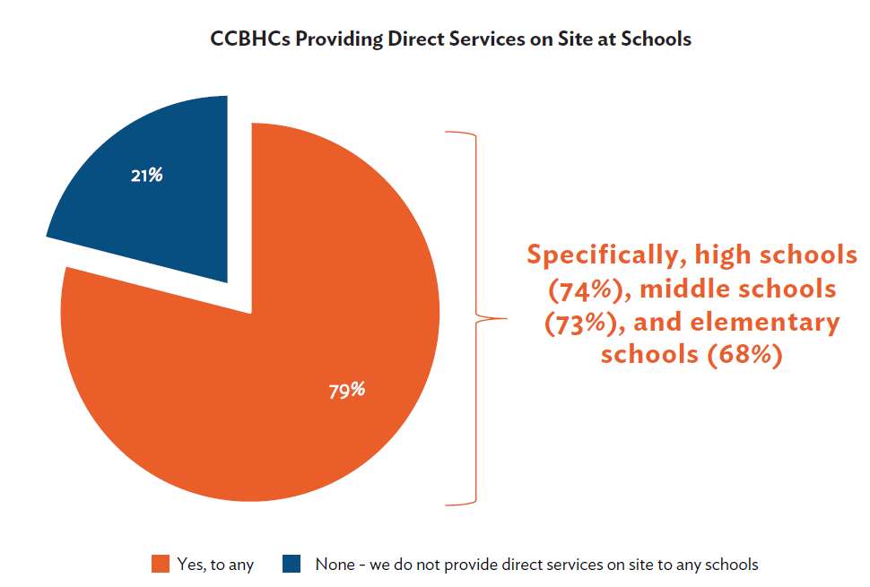
Child & Youth Services
Most respondents (94%) directly deliver services to children and youth; others (8%) collaborate with a DCO for child/youth services.

Slide 19
Activities to Address Health Disparities
*Percent is less than 1% but greater than 0%

Slide 20
SAMHSA CCBHC Expansion Grants vs. Medicaid CCBHC Demonstration
Medicaid CCBHC Demonstration | SAMHSA CCBHC Expansion Grants
Open to only 10 additional states every 2 years | Open to individual clinics in ALL states
Administered by state Medicaid and Behavioral Health authorities within guidelines set by SAMHSA/CMS | Administered by SAMHSA
States determine certification criteria using SAMHSA guidance as a baseline | Grantees must meet SAMHSA baseline CCBHC certification criteria
CCBHCs are certified by their states | CCBHCs are funded by SAMHSA; do not receive state certification
CCBHCs receive special Medicaid payment methodology (known as PPS) | CCBHCs receive up to $4M; continue to bill Medicaid and other payers per usual

Slide 21
Bipartisan Safer Communities Act Expands CCBHC Demonstration Nationwide
Beginning July 1, 2024, and every 2 years thereafter, allows 10 additional states to join the demo
Provides 4 years of enhanced Medicaid match for CCBHC services (E-FMAP)
Makes planning grants available for new states to develop proposals to participate
Appropriates $40M for planning grants and technical assistance to states applying for the grants
Requires annual reports to Congress through the year in which the last demonstration ends

Slide 22
Substance Use Disorder

Slide 23
SUD Policy Priority: Elimination of X-Waiver
The DEA had required an additional waiver to prescribe buprenorphine for the treatment of opioid use disorders (OUD).
Only 1 in 10 people with OUD receive medications for their condition, including buprenorphine.
No such requirement exists for providers licensed to prescribe opioids to treat pain or for other substance use and mental health medications that are also DEA controlled substances.
The additional waiver needed to prescribe buprenorphine for OUD further stigmatizes the medication and deters prescribers from engaging in care.
The Consolidated Appropriations Act of 2023 included the Mainstreaming Addiction Treatment Act (“MAT” Act, H.R. 1384/S. 445) removing the aforementioned waiver requirement.

Slide 24
SUD Policy Priority: Medicaid Reentry Act
According to the Bureau of Justice Statistics, nearly half of people in the criminal justice system have a diagnosable mental health condition. Of those with serious mental illness (e.g., schizophrenia), approximately 75% also have a co-occurring SUD.
The first two weeks after release from incarceration, a person is at the highest risk for an overdose.
The Medicaid Reentry Act (S.285, H.R. 955) allows Medicaid payment for medical services furnished to an incarcerated individual during the 30-day period preceding the individual's release.

Slide 25
SUD Policy Change: Mobile OTP Units
On July 28, 2021, the DEA authorized OTPs to add a “mobile component” to their existing registration, eliminating a separate registration requirement for mobile medication units of OTPs.
On September 29,2021, SAMHSA released additional guidance clarifying the range of services that can be provided in both mobile and non-mobile medication units.
On December 16, 2022, HHS published a notice of proposed rulemaking in the Federal Register seeking comments on various OUD services. The proposed rule clarifies the use of mobile OTP units
The Consolidated Appropriations Act of 2023 included a provision allowing the use of mobile OTP units.

Slide 26
Institutions for Mental Disease (IMD) Exclusion

Slide 27
IMD Exclusion: History and Current Status
Prohibits states from using Medicaid to pay for care provided in institutions for mental disease (IMD)
IMDs include psychiatric hospitals/residential treatment facilities with 16+ beds
Enacted in the Medicaid program in 1965
Recently, there have been new mechanisms for states to finance IMD services, including:
Section 1115 Demonstration Waivers
Managed care “in lieu of” authority
Disproportionate Share Hospital payments
SUPPORT Act state plan option
Allows states to use federal Medicaid funds for IMD SUD services up to 30 days/year
In FY20, five states reported plans to pursue this option: ID, IN, NH, SD, TN

Slide 28
Questions
Reyna Taylor, SVP Public Policy and Advocacy reynat@thenationalcouncil.org
Or
National Council’s policy team at policy@thenationalcouncil.org

