Slide 1
Strategic Partnerships - The Real-Life Stories
Wednesday, October 20, 2021

Slide 2
John MacIntosh
John MacIntosh is the Managing Partner of SeaChange Capital Partners which helps nonprofits work through complex financial and organizational challenges by providing grants, loans and consulting. Since 2009, SeaChange has supported hundreds of nonprofit leaders – with grants, pro-bono consulting and referrals – explore various forms of sustained collaboration including mergers, JVs, back-office sharing, etc. John has been directly involved in more that 500 explorations and 200+ grants. Prior to joining SeaChange in 2008, John was a partner at Warburg Pincus in that global private equity firm’s New York, Tokyo, and London offices. Earlier in his career John worked as a software engineer and a management consultant. John has a BSE from Princeton University and an MSc in Philosophy and Public Policy from the London School of Economics. In conjunction with his role at SeaChange, he serves as an observer on a number of nonprofit boards and is a trustee of the John Jay Foundation, the Brooklyn Heights Association, and the Putney School.

Slide 3
Keith Little
Keith M. Little was appointed President & CEO of SCO Family of Services on January 1, 2018. In this role, he is responsible for oversight of the agency’s extensive continuum of residential and community-based child welfare, early childhood, youth development, family support, special needs, and homeless services.
A hands-on leader with over 30 years of experience at state, city, and nonprofit organizations, Mr. Little brings considerable expertise in the provision of mental health, health care, child welfare, and juvenile justice programs.
He has held senior organizational and program leadership positions at the New York State Office of Mental Health. He served as Associate Commissioner and Deputy Director at OMH, where he was responsible for the oversight of State Operations.
His experience includes posts at the Jewish Board of Family and Children’s Services and the New York City Department of Health. Mr. Little earned an MPA from Baruch College, City University of New York, and a bachelor’s degree from University of Bridgeport. He sits on the Boards of Directors of COFCCA; the Collaboration of Children and Families (CCF); the Priority and Strategy Council for the Human Services Council; Intellectual and Developmentally Disabled Child Welfare Collaboration; and the Black Agency Executives.

Slide 4
Sherry Tucker
Sherry Tucker began her career at WellLife Network in 2010 as a financial consultant. She helped lead the effort to bring the organization to a place of financial stability. In 2015 Sherry accepted the Chief Financial Officer/Senior Vice President position and was instrumental in coordinating the efforts to merge three behavioral health agencies, PSCH, Pederson-Krag Center, and Peninsula Counseling Center into one organization. She also rebranded the newly formed entity to WellLife Network. On July 1, 2018 Sherry assumed the responsibility of CEO of the Agency. Today, WellLife Network, one of the largest regional behavioral health nonprofits in New York City and Long Island, provides life-changing services to 25,000 vulnerable individuals and families each year.

Slide 5
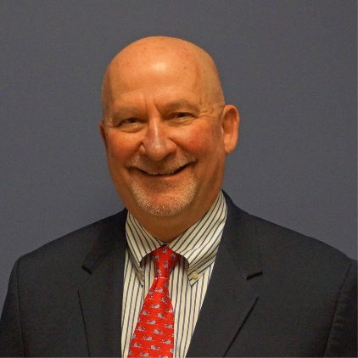
Robert Hettenbach
Robert Hettenbach is a healthcare executive with over 4 decades of experience in business, government, hospitals, health systems, and community-based organizations. Current activities focus on enhancing strategy, performance, and viability of community-based organizations and their integration with the larger system.
He introduced the use of computers to analyze demographic and performance data to clients including Mobil Oil, NY Yankees, the Equitable Life Assurance Company, NY Telephone, and South Beach Psychiatric Center, where he began his journey in healthcare.
Mr. Hettenbach’s work at the NYS Office of Mental Health included hospital leadership at the Bronx and Kings Park Psychiatric Centers and NYC Regional Director managing state operations and city-state-federal inter-governmental agreements on Veterans, homelessness, hospital overcrowding, and the state’s Community Re-Investment act.
At Northwell Health, he was Forest Hills Hospital Executive Director, interim CEO at Peconic Bay Medical Center, system-wide Chief Operating Officer of Behavioral Health Services, and developed Hillside Behavioral Health IPA and LIJ’s network of primary care and medical specialty IPAs.
Mr. Hettenbach was President of Well Life Network, founder and board member of Coordinated Behavioral Care, and founder and board chair of Advanced Health Network IPA, Long Island’s largest behavioral health network.
He lead NQP LLC created by Northwell, Catholic Health Services, and NuHealth for DSRIP, engaging providers to enhance services in Nassau and Queens counties.
He is on the Board of Directors of Well Life Network and the Mental Health Association of Nassau County.
Throughout his career, Mr. Hettenbach has addressed the quality of care for underserved and diverse populations and enhanced clinical, service, and financial performance through patient and staff engagement, staff training and empowerment, transparency, and accountability.

Slide 6
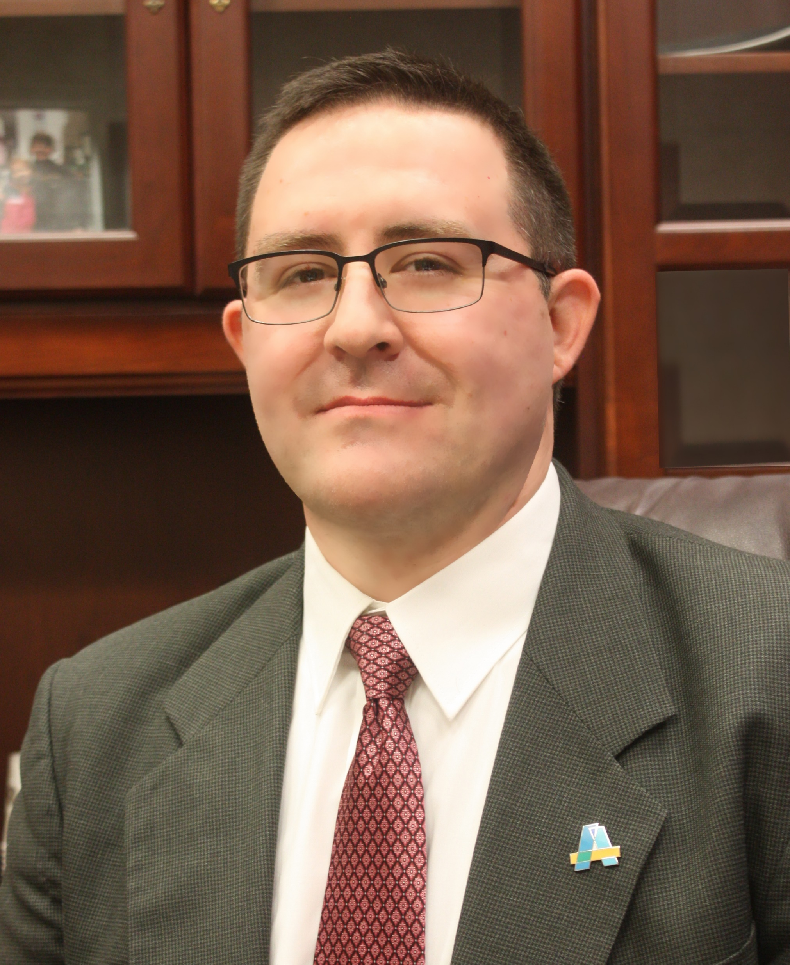
Ron Colavito
Ron Colavito joined Access: Supports for Living in 2003 as a cost accountant before being promoted to Comptroller in 2009, then Senior Vice President of Industrial Operations and Program Services in 2014. In February 2015, Ron became Access’s Chief Operating Officer, and Executive Vice President & COO in October 2017. In 2019, Ron Colavito became the fifth Chief Executive Officer in the agency’s 55 year history.
Today, Ron is Access’s President & CEO, leading a team of over 1,500 dedicated staff providing supports and services to more than 11,000 adults and children with a range of needs, including mental health and intellectual and developmental disabilities, throughout the Hudson Valley. Ron is also President of The Guidance Center of Westchester, an affiliate of Access.
Ron serves on the Boards of: The Coalition for Behavioral Health; NYDA; CBHS, Inc.; New York Alliance for Inclusion and Innovation; Care Design NY; the Newburgh Armory Unity Center; Hudson Valley Economic Development Corporation, where he serves on the Executive Committee; NYIN, where he serves as Secretary; and NYIN IPA, where he serves as Vice-Chair.
He holds a Bachelor of Science in Accounting from SUNY Geneseo and an MBA in Healthcare Management from Quinnipiac University.

Slide 7
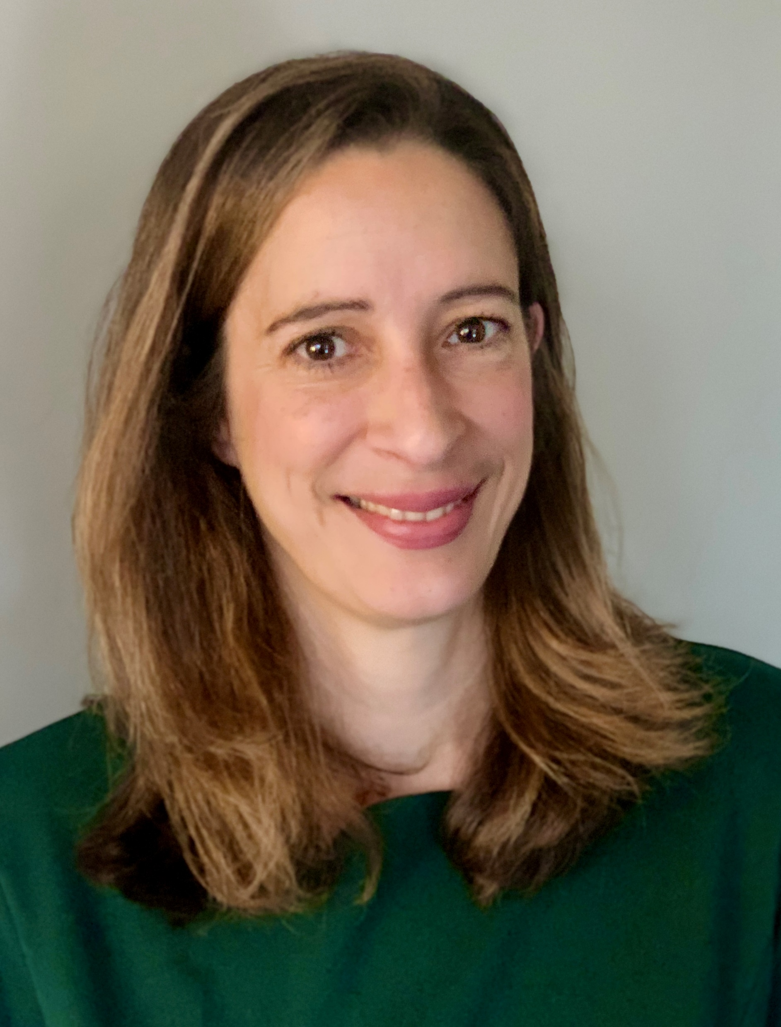
Elizabeth Perez
Since 2019, Elizabeth Perez has served as the Compliance Officer and Counsel at East Harlem Council for Human Services. A member of the Council's executive staff, she is responsible for ensuring compliance with laws and regulations applicable to the Council's health center, head start and senior center programs. In her prior role as Legal Director at Lawyers Alliance for New York, Ms. Perez oversaw the provision of pro bono legal services to nonprofits across New York City. In her 13 years of service as a public interest attorney, Ms. Perez has aimed to support organizations addressing equity and quality of life for all New Yorkers, and she is especially passionate about access to quality health care. She received her J.D. from Columbia University School of Law in 2004, an LL.M. from the University of London in 2004, and a B.A. from Texas A&M University in 2000.

Slide 8
QUESTIONS

Slide 9
Industry Consolidation Workgroup Members
Keith Little, CEO, SCO Family of Service
John MacIntosh, Managing Partner, Sea Change
Beth Covelli, Executive Director, New York Counseling for Change, LLC
Jeremy Klemanski, President & CEO, Helio Health
Monica Oss, CEO & Senior Associate, Open Minds
Penny Greene, Associate Executive Director, Farnham Family Services
Sherry Tucker, CEO, WellLife Network
Fern Zagor, Principal, Fern Zagor Consulting
Matthew Burke Partner Cerini and Associates, CPA's, LLP

