Slide 1
Advancing NYS Prevention Agenda and Behavioral Health through Health Care and Community Partnerships
David Cohen, MD, MSc, Executive VP for Population Health and Academic Affairs, Maimonides Medical Center
Kishor Malavade, MD, Vice Chair and Chief Medical Officer, Department of Population Health, Maimonides Medical Center

Slide 2





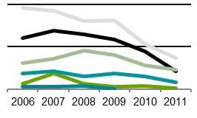

Milestones
CCB IPA approved as a Medicare ACO
Launched Mental Health Home with HEAL 10/17 to improve care for SMI
Expansion of mental health model, training, and HIT
2005 2006 2010 2011 2012 2014 2015 2017 2018 2019 2020 2021+
CMMI study results published
COVID-19 activities to support partners
MMC establishes Department of Population Health
Co-location of primary care & behavioral health services at South Beach Psychiatric Center
Brooklyn Communities Collaborative (BCC) forms

Slide 3
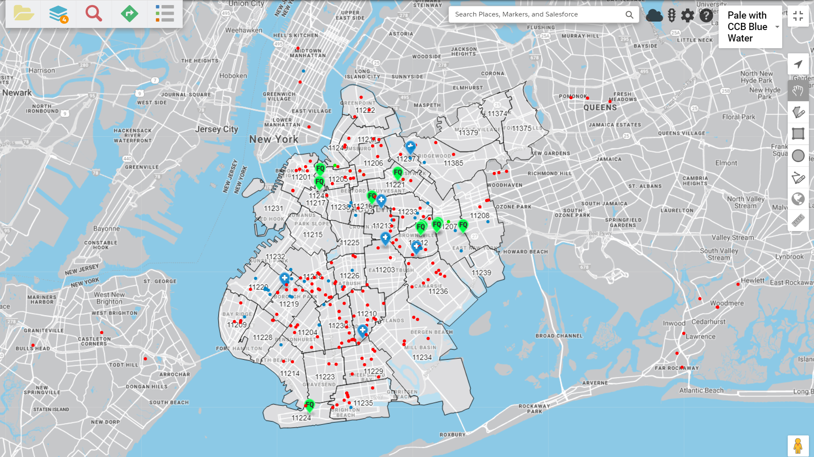

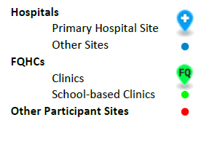
Brooklyn-wide network
  106 entities participating in CCB IPA network
    470+ PCPs
    6 Hospitals
    5 FQHCs
    16 NYS OASAS substance use programs
    27 NYS OMH mental health programs
  8 entities participating in this project, representing 12 participating Brooklyn mental health clinic sites.

Slide 4

Addressing Population Health at Community Level
Schools as community for prevention efforts
  Help 100 public schools establish wellness programs to:
    mental health literacy
    high-risk choices, stigma around behavioral health issues
  Improve access by establishing links to hospitals, community treatment, care coordination and crisis response resources
AMEMSA community as focus for prevention efforts
    Partnership led by Arab American Family Support Center (AAFSC)
    Focus on de-stigmatization and increasing mental health literacy
    Training on community resilience model, including train the trainer
    Technical assistance and support from UCLA, NYC DOHMH
    Training for faith leaders and CBOs serving community to be able to identify and address low level mental health issues, and connections to care when clinical needs arise

Slide 5
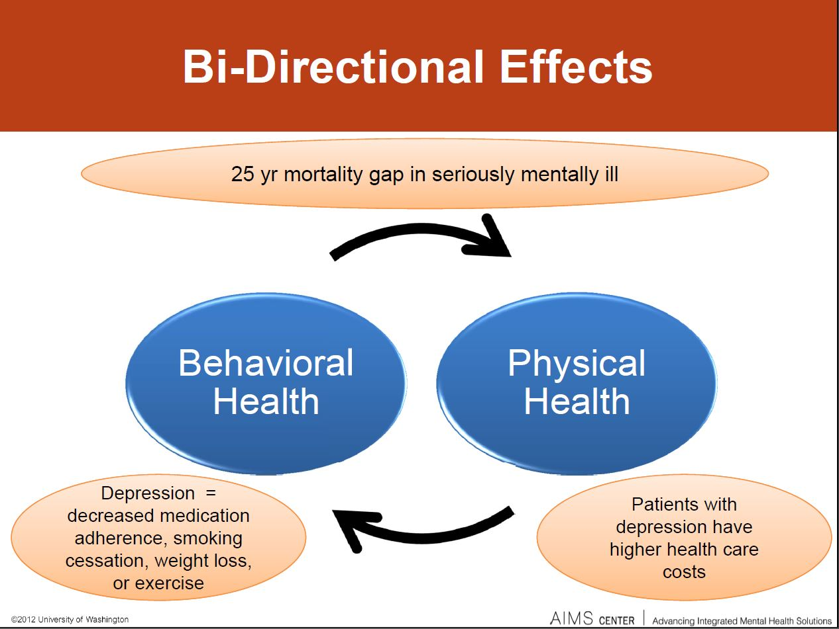
Background
Mental health clinics are well-positioned to address care gaps because patients are generally seen there more often than in other settings.
Mental health clinics have not broadly adopted best practices in population health management, and have little insight into patients’ physical health needs.
Notes:
Patients with untreated depression and a chronic illness have monthly healthcare costs that average $560 higher than those with just a chronic disease, according to the American Hospital Association.
Other studies have estimated it can cost as much as three times more to treat the physical health of a patient with underlying behavioral health issues than it does to treat the same physical health issues in a patient without a mental health disorder.
such as:
EMR registries
Huddles/pre-visit planning
Monitoring patient access
Tracking key primary care clinical values
Smoking cessation

Slide 6
Integrating behavioral health into primary care
Increase screening for depression, anxiety, substance use disorders
Provide technical support and assistance to implement collaborative care
Funding for behavioral health coaches
Establish collaborative agreements with mental health partners for primary care practices with barriers to integrating services at the practice level
Provide sustainability pathway through connection to NYS Medicaid Pilot Program for collaborative care
Worked with OB Gyn practices to screen for depression and anxiety at first prenatal visit, 35 weeks, post partum, and first well child visit
Over 215,000 screenings for depression, anxiety, and substance use disorders

Slide 7


Introducing primary care best practices to mental health clinics
  Develop population health EMR registries
  Meet monthly coordination activity targets driven by EMR registries
  Complete daily pre-visit planning and huddles
  Refer patients to NY State Smokers’ Quitline
  Maintain sufficient access to care post-hospitalization (within 7 days of discharge)
  Improve performance on relevant quality measures
Notes:
Designated staff identified for coordination activities include:
Health Coaches
Social Work Assistants
MMC provides support to each organization
Pictures = AMA

Slide 8
Methods
HEDIS Measure Name | Associated EMR Registry | Monthly Registry Activities Reported to MMC
Medication management for patients on antidepressants (12-week acute treatment phase) | Antidepressant Registry | Number of patients with whom the staff confirmed medication adherence within 12 weeks and 6 months of starting the antidepressant
Medication management for patients on antidepressants (6 months)
Antipsychotic adherence for patients with schizophrenia | Antipsychotic Registry | Number of patients prescribed antipsychotic medications for which the practice either (1) completed a diabetes screening onsite or (2) obtained results from an external provider/organization from within the calendar year Number of patients with whom the staff confirmed antipsychotic medication adherence
Diabetes screening for patients prescribed antipsychotics
Diabetes monitoring for patients with schizophrenia and DM | Schizophrenia Comorbidity Registry | Number of patients with SCZ and CVD who either completed a LDL-C test on-site or obtained results from an external provider Number of patients with SCZ and DM who either completed a LDL-C and HbA1c test on-site or obtained results from an external provider
CVD monitoring for patients with schizophrenia and CVD
Follow-up care for children prescribed ADHD medications – Initiation Phase | Pediatric ADHD Registry | Number of patients ages 6-12 for whom the staff scheduled or confirmed a follow-up visit within 30 days of starting ADHD medication (initiation phase) and within 9 months of initiation phase
Follow-up care for children prescribed ADHD medications – Continuation Phase
Notes:
Measure Numerator
Measure Denominator
Number of patients who remained on antidepressant medication during the entire 12-week acute treatment phase
Number of patients 18 and older who were diagnosed with depression and treated with an antidepressant medication
Number of patients who remained on antidepressant medication for at least 6 months
Number of patients ages 18 and older who were diagnosed with depression and treated with an antidepressant medication
Number of patients who remained on an antipsychotic medication for at least 80% of their treatment period
Number of patients ages19-64 with schizophrenia who were dispensed at least 2 antipsychotic medications during the measurement year
Number of patients who had a diabetes screening test during the measurement year
Number of patients ages 18-64 with schizophrenia or bipolar disorder who were dispensed an antipsychotic medication
Number of patients who had both an LDL-C test and an HbA1c test during the measurement year
Number of patients ages 18-64 with schizophrenia and diabetes
Number of patients who had an LDL-C test during the measurement year
Number of patients ages 18-64 with schizophrenia and cardiovascular disease
Number of children who had 1 follow-up visit within 30 days after starting the medication
Number of children ages 6-12 who were newly prescribed ADHD medication
Number of children who, in addition to the visit in the initiation phase, had at least 2 follow-up visits in the 9 month period after the initiation phase ended
Number of children ages 6-12 who were newly prescribed ADHD medication and remained on the medication for 7 months

Slide 9
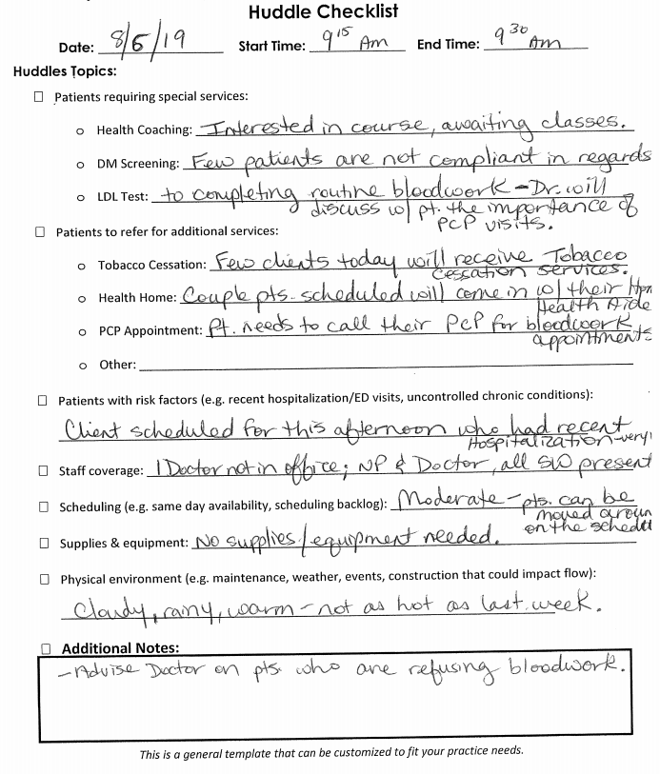
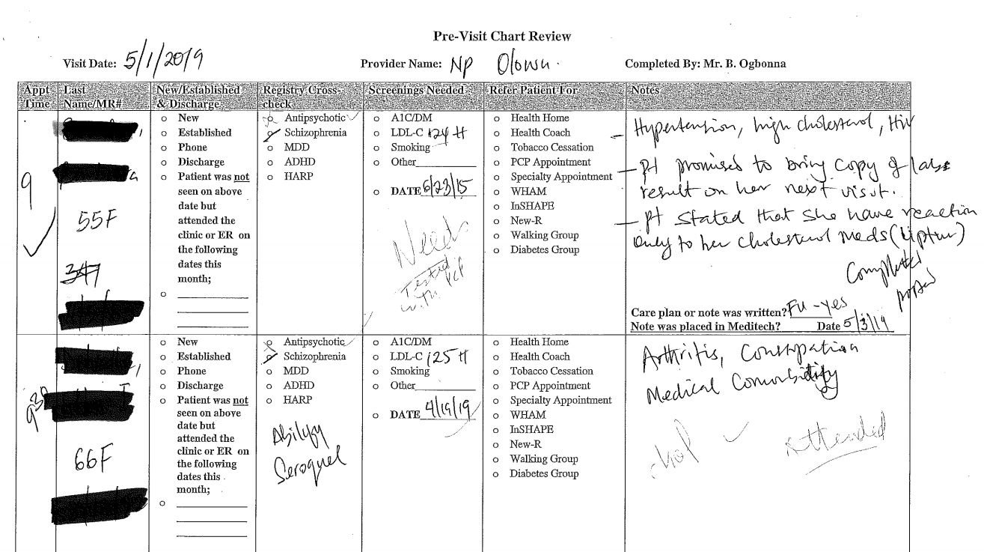
Huddles/pre-visit planning

Slide 10

Improving Care Transitions
Targeting vulnerable patients, high utilizers, patients with limited social supports
Interventions:
  Transitional care teams, ED care navigators
  Engagement in hospital, follow-up in community
  Connecting patients to community-based treatment and support, including non-clinical drivers of utilization
Network of Support Services:
  Linkage to Health Home care management
  Health Coaches (primary care, mental health)
  Substance use/mental health peers
  SNF transitional nurses
  Referrals for free legal assistance
Focus on Performance Improvement:
  Agreements include both process and outcomes targets
  Leadership/staff meet monthly to implement action plans

Slide 11
Does peer support make a difference?
Increased self esteem and confidence^{1, 2}
Increased empathy and acceptance (camaraderie)^{1, 3}
Increased sense of control and ability to bring about changes in their lives⁴
Increased sense that treatment is responsive and inclusive of needs⁴
Increased engagement in self care and wellness⁴
Increased social support and social functioning^{5, 6, 7, 8, 9}
Reduced hospital admission rates and longer community tenure^{4, 10, 11, 12}
Decreased substance use and depression⁴

Slide 12
Proven Impact of Care Coordination
CMMI Innovation Grant: Supported programs and related technology to coordinate behavioral health, primary care, and social services for 7,500 patients with severe mental illness
Saved Medicaid $944 per beneficiary per month, for a total savings of $48 million
Resulted in significantly fewer hospitalizations
Implemented program successfully:
  94% received care management services
  Care managers built strong and consistent relationships, played key roles connecting to housing and other social supports
Web-based platform is a useful tool to support care coordination
Experience with similar projects, network of partners, and creative use of funding sources contributed to successful implementation and sustainment of program components

Slide 13
References
Davidson, L., Chinman, M., Kloos, B., Weingarten, R., Stayner, D., & Tebes, J. K. (1999). Peer support among individuals with severe mental illness: A review of the evidence. Clinical psychology: Science and practice, 6(2), 165-­‐187.
Salzer, M. S. (2002). Consumer-­Delivered Services as a Best Practice in Mental Health Care Delivery and The Development of Practice Guidelines: Mental Health Association of Southeastern Pennsylvania Best Practices Team Philadelphia. Psychiatric Rehabilitation Skills, 6(3), 355‐382.
Coatsworth-­Puspoky, R., Forchuk, C., & Ward-­Griffin, C. (2006). Peer support relationships: an unexplored interpersonal process in mental health. Journal of psychiatric and mental health nursing, 13(5), 490-­497.
Davidson, L., Bellamy, C., Guy, K., & Miller, R. (2012). Peer support among persons with severe mental illnesses: a review of evidence and experience. World Psychiatry, 11(2), 123-­128.
Kurtz, L. F. (1990). The self‐help movement: Review of the past decade of research. Social Work with Groups, 13(3), 101-­115.
Nelson, G., Ochocka, J., Janzen, R., & Trainor, J. (2006). A longitudinal study of mental health consumer/survivor initiatives: Part 1—Literature review and overview of the study. Journal of Community Psychology, 34(3), 247‐260.
Ochocka, J., Nelson, G., Janzen, R., & Trainor, J. (2006). A longitudinal study of mental health consumer/survivor initiatives: Part 3—A qualitative study of impacts of participation on new members. Journal of Community Psychology, 34(3), 273-­283.
Trainor, J., Shepherd, M., Boydell, K. M., Leff, A., & Crawford, E. (1997). Beyond the service paradigm: The impact and implications of consumer/survivor initiatives. Psychiatric Rehabilitation Journal, 21(2), 132-­140.
Yanos, T. P., Primavera, L. H., & Knight, E. L. (2001). Consumer-­run service participation, recovery of social functioning, and the mediating role of psychological factors. Psychiatric Services, 52(4), 493‐500.
Chinman, M. J., Weingarten, R., Stayner, D., & Davidson, L. (2001). Chronicity reconsidered: improving person‐environment fit through a consumer-­run service. Community mental health journal, 37(3), 215-­229.
Forchuk, C., Martin, M. L., Chan, Y. L., & Jensen, E. (2005). Therapeutic relationships: From psychiatric hospital to community. Journal of psychiatric and mental health nursing, 12(5), 556­‐564.
Min, S. Y., Whitecraft, J., Rothbard, A. B., & Salzer, M. S. (2007). Peer support for persons with co-­‐occurring disorders and community tenure: a survival analysis. Psychiatric rehabilitation journal, 30(3), 207-­213.

